Slide 1

IS 436: Harshitha Sayini, Nishan Subba, Dhulfiqar Hussein, Trevin Nisbett, Aman Gurung, Chiagoziem Igwe

Slide 2
Intro
In today's digital era, businesses benefit from streamlined operations and efficiency, often achieved through modern software solutions. We recognize Gorilla Distribution Center's dedication to its operations and employees. With this in mind, we present our proposal: A state-of-the-art digital payroll system tailored to meet the unique requirements and challenges faced by Gorilla Distribution Center.

Slide 3
Issue at Hand
Gorilla Distribution Center currently employs handwritten methods for payroll processing.
Prone to human error
Time consuming
Not very efficient
This can lead to pay discrepancies, salary disbursement delays, and potential disputes which can negatively impact employee morale and operational efficiency.

Slide 4
Proposed Solution: Digital Payroll System
This system is designed to address the monotony and errors associated with manual payroll processes.
The system has automated payroll features which ensures that salaries are accurately computed in real-time.
Employees hours worked, overtime, any bonuses and any necessary deductions.
Managers are able to review, adjust, and grant approval for payrolls, which ensures that the entire process is transparent and accountable.
Lastly, the system is equipped with advanced reporting tools that can generate comprehensive payroll reports.

Slide 5
Why Choose Avalanche Innovation Team
Years of Experience and Expertise
Custom solution specifically tailored for you.
Adaptability and future ready.
Robust data integration and security.
Comprehensive support, including but not limited to training and post deployment maintenance.
Collaborative and transparency to ensure you are part of the project.

Slide 6
Project Timeline
IS436 Group 7 - Estimated Project Timeline
Date | Tasks | Weekly Meeting Agenda
10/01 - 10/15 | 1. Deliverable 1 - System Request 2. Division of Work/Roles 3. GitHub Project Modification 4. Kanban Board 5. Set-Up GitHub Collaboration | 1. Discuss Project Proposal 2. Start Working on Deliverable 1 3. Get involved in the GitHub Project
10/09 - 10/22 | 1. Work on Deliverable 2 2. Work on Functional requirements 3. Work on Non-functional Requirement 4. Start thinking of interview information 5. Create a set of questions for the interview 6. Implement Feedback from D1 | 1. Start thinking of deliverable 2 2. Think of requirements for the project 3. Get some Use Cases 4. Division of Work 5. Think of interviews

Slide 7
Project Timeline Cont.
Date | Tasks | Weekly Meeting Agenda
10/16 - 10/22 | 1. Work on interview and documentation 2. Get observation notes 3. Documentation of all resources and questions used 4. Use case analysis 5. Use case diagram 6. Implement Feedback from D1 7. Finish and Submit Deliverable 2 | 1. Interview, Interview, Interview 2. Documentation
10/23 - 10/29 | 1. Work on Deliverable 3 2. Start Working in Developing the project 3. Website Design 4. ERD Documentation 5. Implement Feedback from D2 | 1. Division of work 2. Making UI/UX Designs for the website 3. Thinking of database 4. Working in ERD

Slide 8
Project Timeline Cont.
Date | Tasks | Weekly Meeting Agenda
10/30 - 11/05 | 1. Write Initial Code/Web Dev 2. HTML/CSS/JS/Frameworks 3. Work on Functionality 4. Implement Feedback from D2 5. Finish and Submit Deliverable 3 | 1. Discuss web development and tools that will be used 2. Division of work 3. Start writing initial web dev codes
11/06 - 11/12 | 1. Work on Deliverable 4 2. Work on backend 3. Start working on a database 4. Implement Feedback from D3 | 1. Test, Test, Test, Test, Test 2. Division of work 3. Integration of code 4. Quality Assurance Test, Test, Test

Slide 9
Project Timeline Cont.
Date | Tasks | Weekly Meeting Agenda
11/13 - 11/19 | 1. Finish Backend Code 2. Finish Database 3. Implement Feedback from D3 4. Finish and Submit Deliverable 4 | 1. Test, Test, Test, Test, Test 2. Integration of Code 3. Division of Code 4. Finalize the backend and Database
11/20 - 11/26 | 1. Work on Deliverable 5 2. Quality Assurance Check 3. Bug fixes and Debugging 4. Implement Feedback from D4 | 1. Test, Test, Test, Test, Test 2. Integration of code 3. Division of work 4. Fix any potential bugs and error

Slide 10
Project Timeline Cont.
Date | Tasks | Weekly Meeting Agenda
11/27 - 12/3 | 1. Finalize the project 2. Finish All documentation 3. Implement Feedback from D3 4. Finish and Submit Deliverable 5 5. Work on Presentation | 1. Test, Test, Test, Test, Test 2. Finalize the web app 3. Check for any final errors or bugs 4. Plan for project presentation
12/11 - End of class | 1. Submission of All Documentation and Deliverables 2. Project Presentation | 1. Meet up before presentation 2. Presentation DEMO 3. Celebrate Project Completion

Slide 11
Stakeholders
The stakeholder that would be involved our digital payroll system would be the Gorilla Distribution Center.
This would include employees and managers.

Slide 12

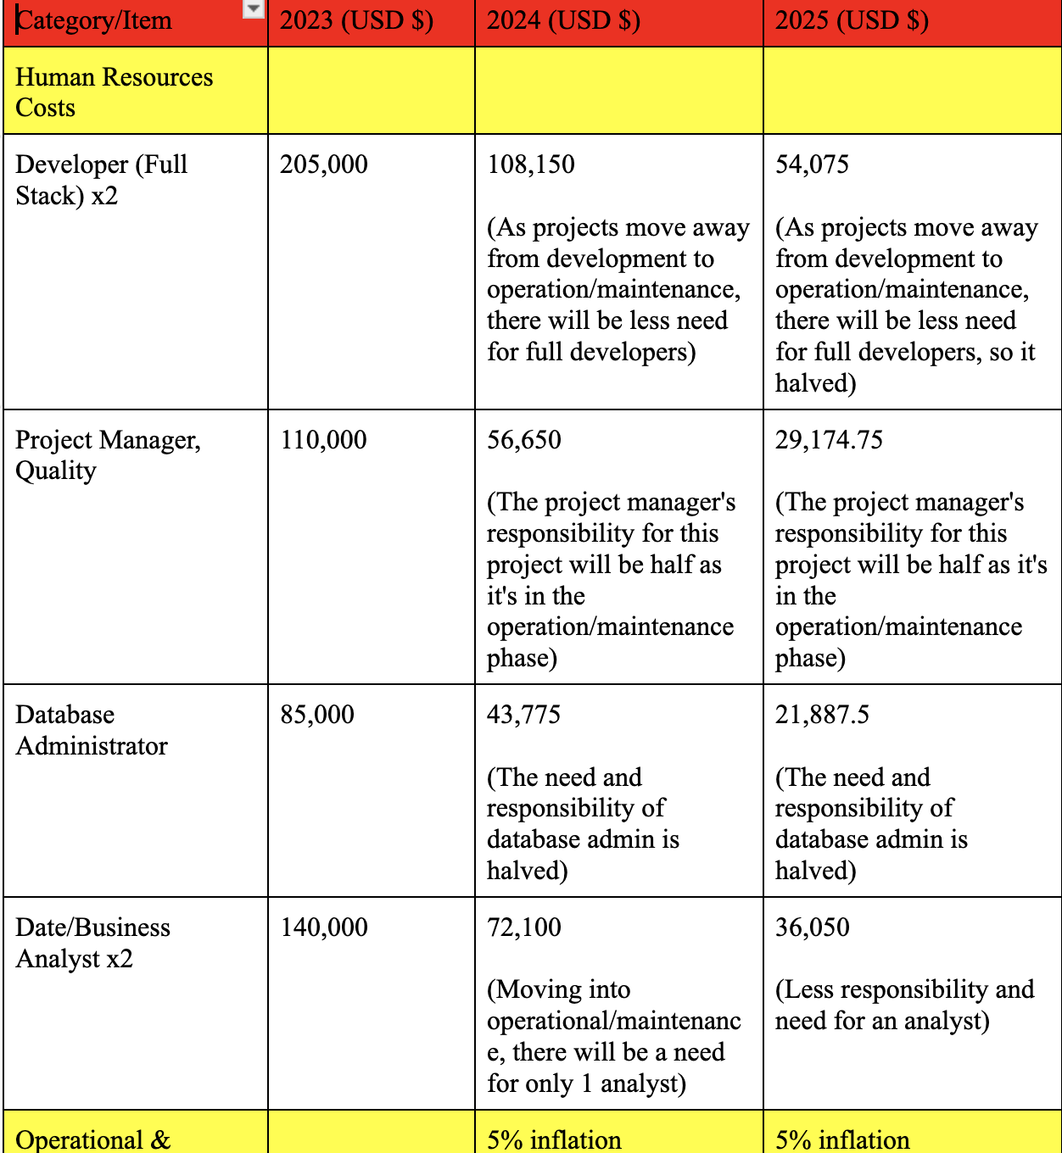
Financial Projection

Slide 13
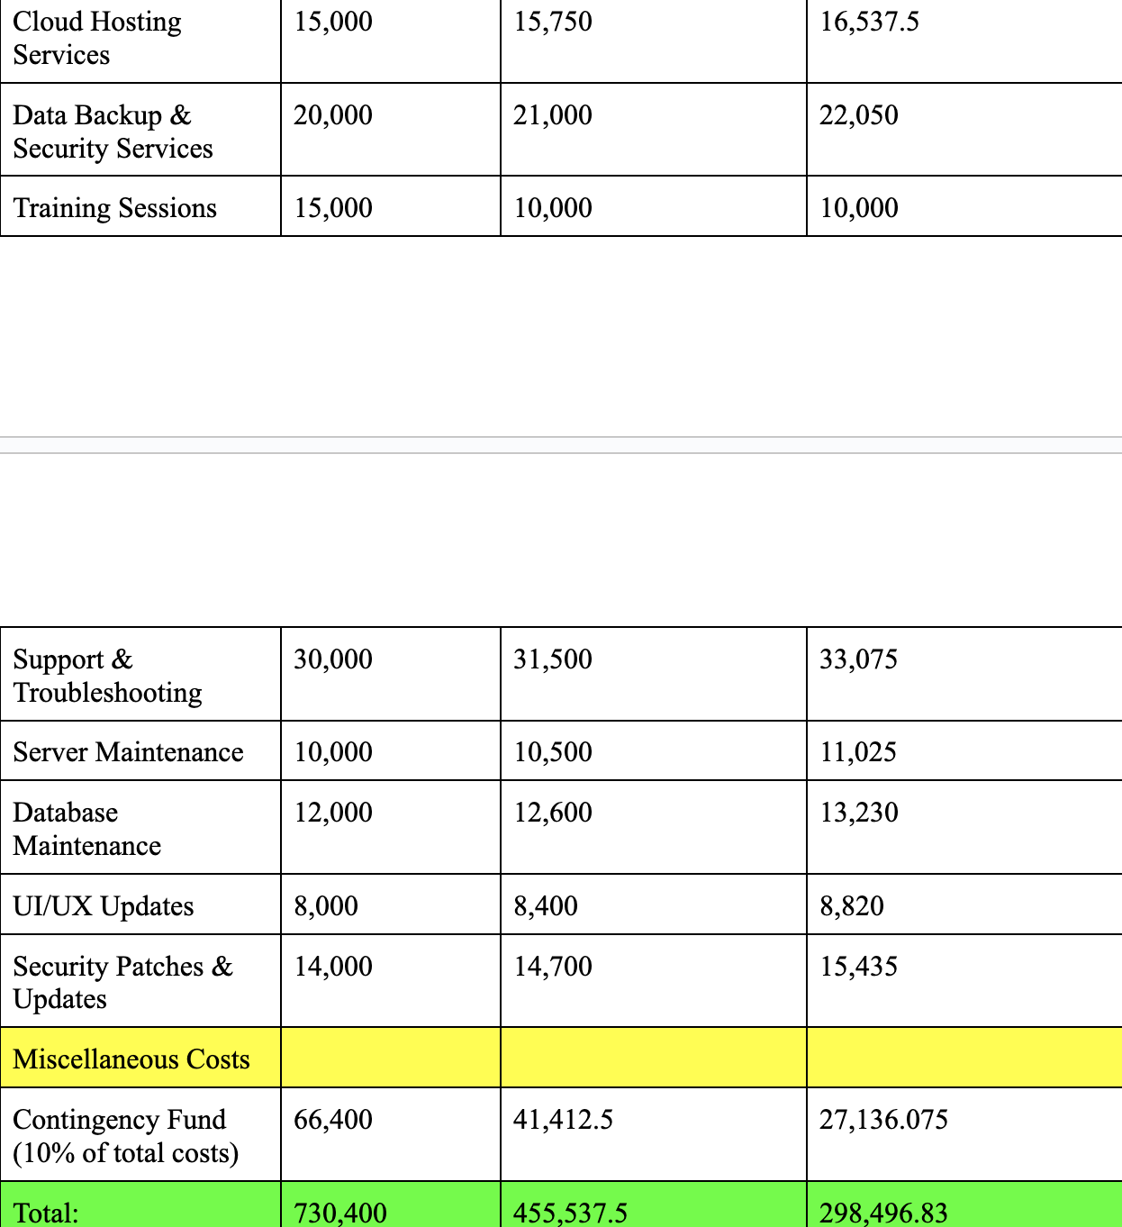

Slide 14
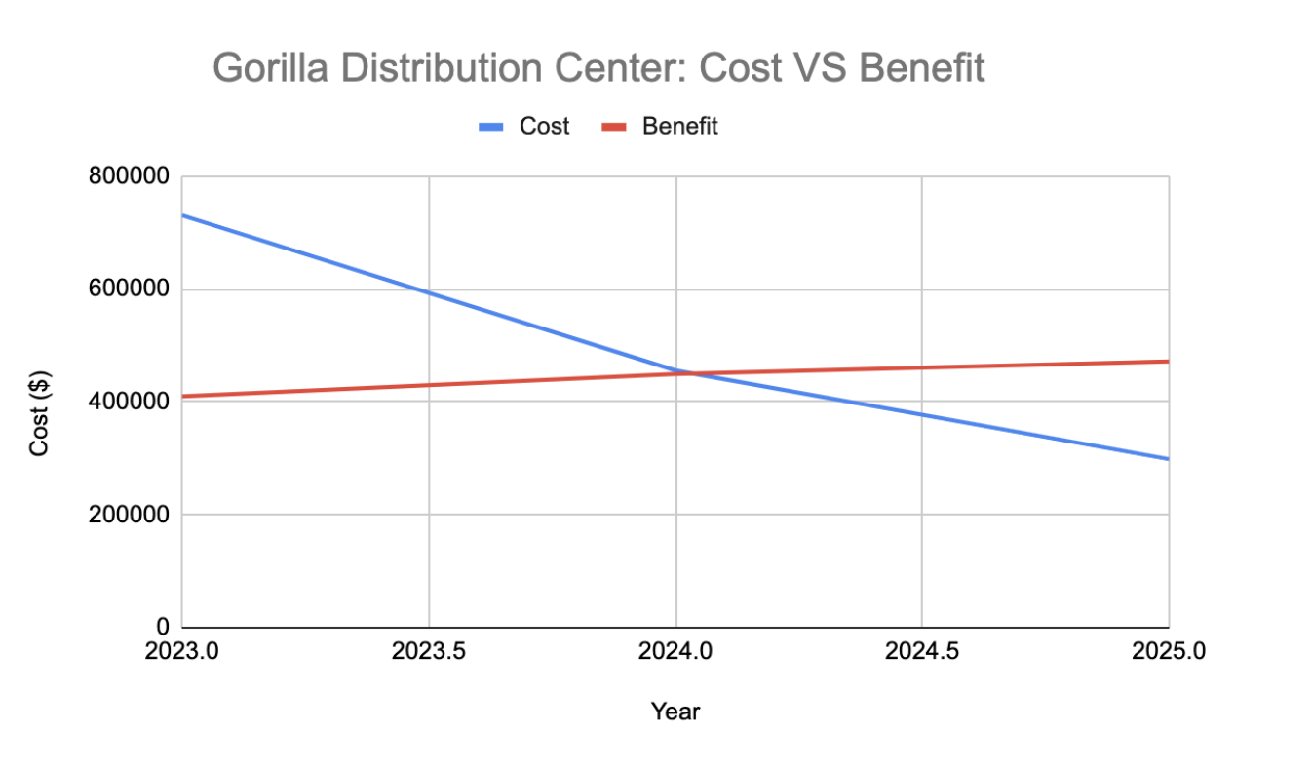

Slide 15
Interview Insights
Interviewed a total of seven employees, ranging from positions such as IT manager, Software Developer, CEO and Founder, Production Technician, Line Manager, Legal/Compliance Officer, and HR Manager.
Key Questions:
Can you describe how the current payroll system impacts your day-to-day operations and responsibilities?
From a budgetary standpoint, are there specific constraints or expectations for the new payroll system?
Do you face challenges in managing overtime, leave, or other specific payroll-related tasks?

Slide 16
User Needs
Through the interview process, we were able to understand the user needs for a new digital payroll system.
Employees emphasized a need for:
Efficiency which means having real time updates and changes.
Convenience such as a notification system to alert any discrepancies in real time.
Safety, ensuring that data is only accessed by authorized individuals.

Slide 17
Use Cases
Manage Employee
Employee Self-Service
Generate Payroll
Sign Up
Sign In

Slide 18
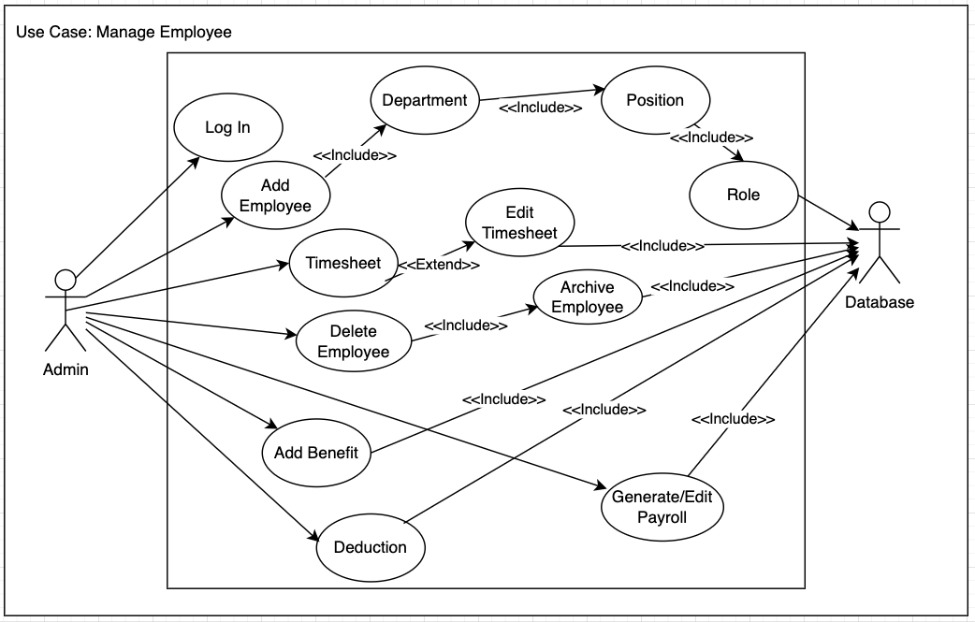
Use Case: Manage Employee
Add/Delete Employee
Assign Department/Position
Add Benefits/Deductions
Edit Timesheet
Generate Payroll
Clock-In/Clock-Out
Add Overtime
Role Assign

Slide 19
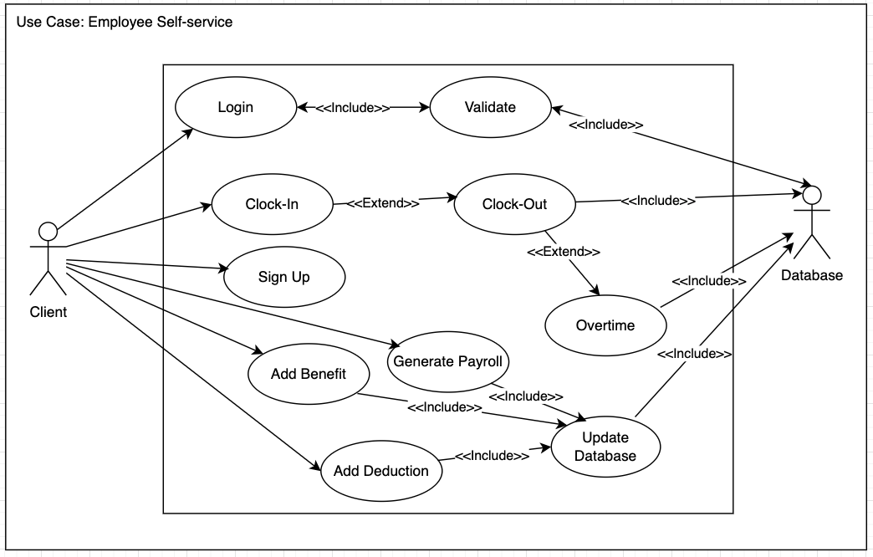
Use Case: Employee Self-Service
Sign In
Create Account
Clock-In/Clock-Out
Add Overtime
Generate Payroll
Add Benefits/Deductions
Add Information to Database

Slide 20
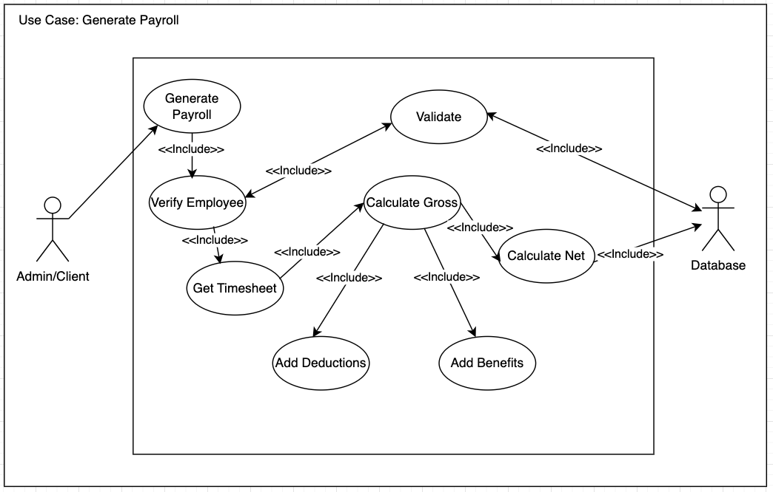
Use Case: Generate Payroll
Validate Timesheet Record
Generate Gross and Net Pay

Slide 21
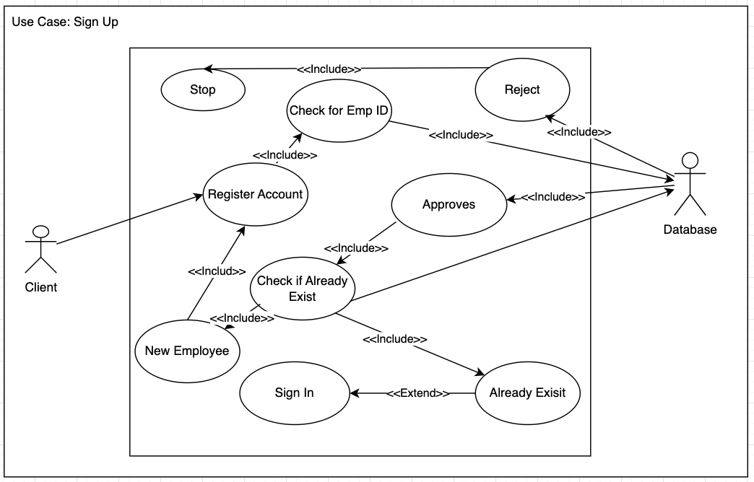
Use Case: Sign Up
Validate Employee Record
Validate Pre-Existing Employee
Add User Information to Database

Slide 22
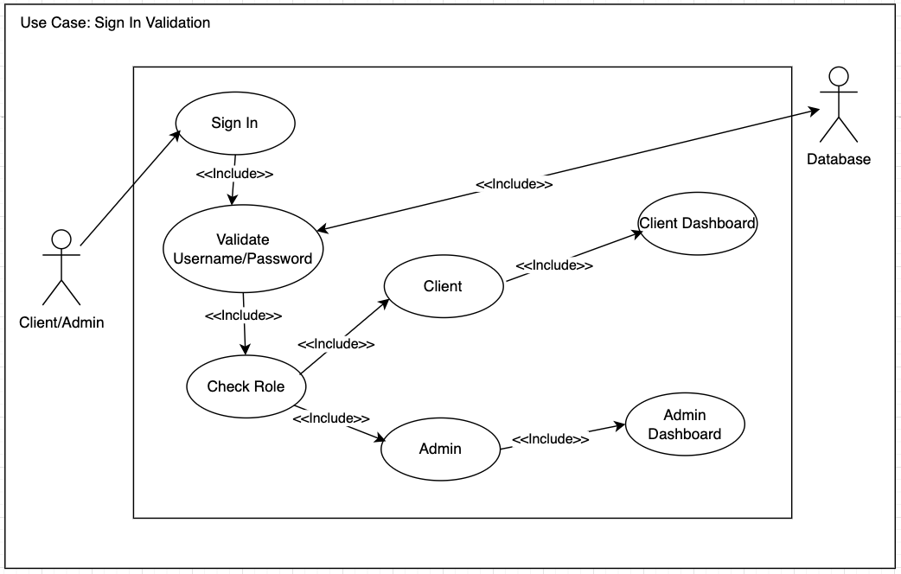
Use Case: Sign In Validation
Validate User Login Information
Check for Role Access
Redirect to Appropriate Dashboard

Slide 23
Database Design
UMBC Maria MySql Database
Focus on normalization
1. No redundant or repeated data
2. Every table has PK and each table is linked with foreign key
12 Tables Design that can handle lot of different data
Created stored procedures for doing complex query such as joining every table or displaying employee's Record
Created stored triggers for automatic calculations such as Generating payroll
Triggers will show real time updates
Prevent Orphan Record when Employee is deleted by deleting all foreign references

Slide 24
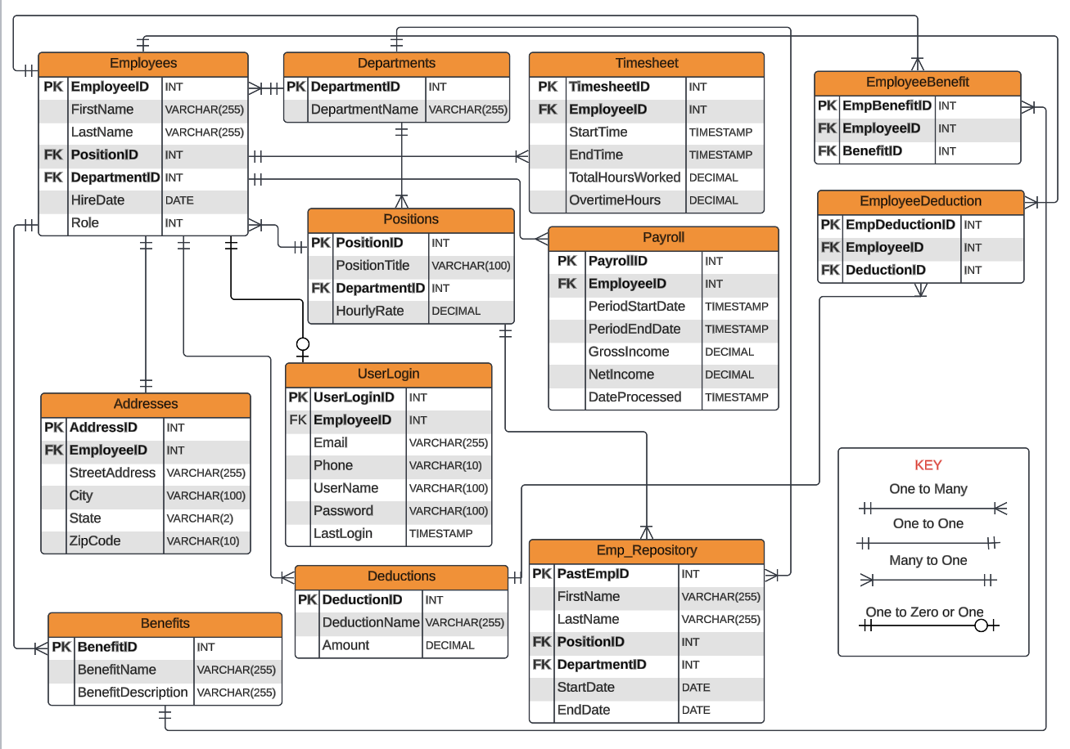
ER Diagram

Slide 25
Technology Components
Hardware/Software Components
 | Standard Client | Standard Web Server | Standard Application Server | Standard Database Server
Operating System | Windows 10 or higher | Windows 10 or higher | Windows 10 or higher | Windows 10 or higher
Software | Google Chrome, Firefox | NGINX | HTML, CSS, PHP, Javascript, Visual Studio Code | MySQL
Hardware | PC or Mobile Device with internet | Dell PowerEdge T630 Server | RAM, Motherboard | Microsoft SQL Server 2022 Standard
Network | LAN, WAN | LAN, WAN | LAN, WAN | LAN, WAN

Slide 26
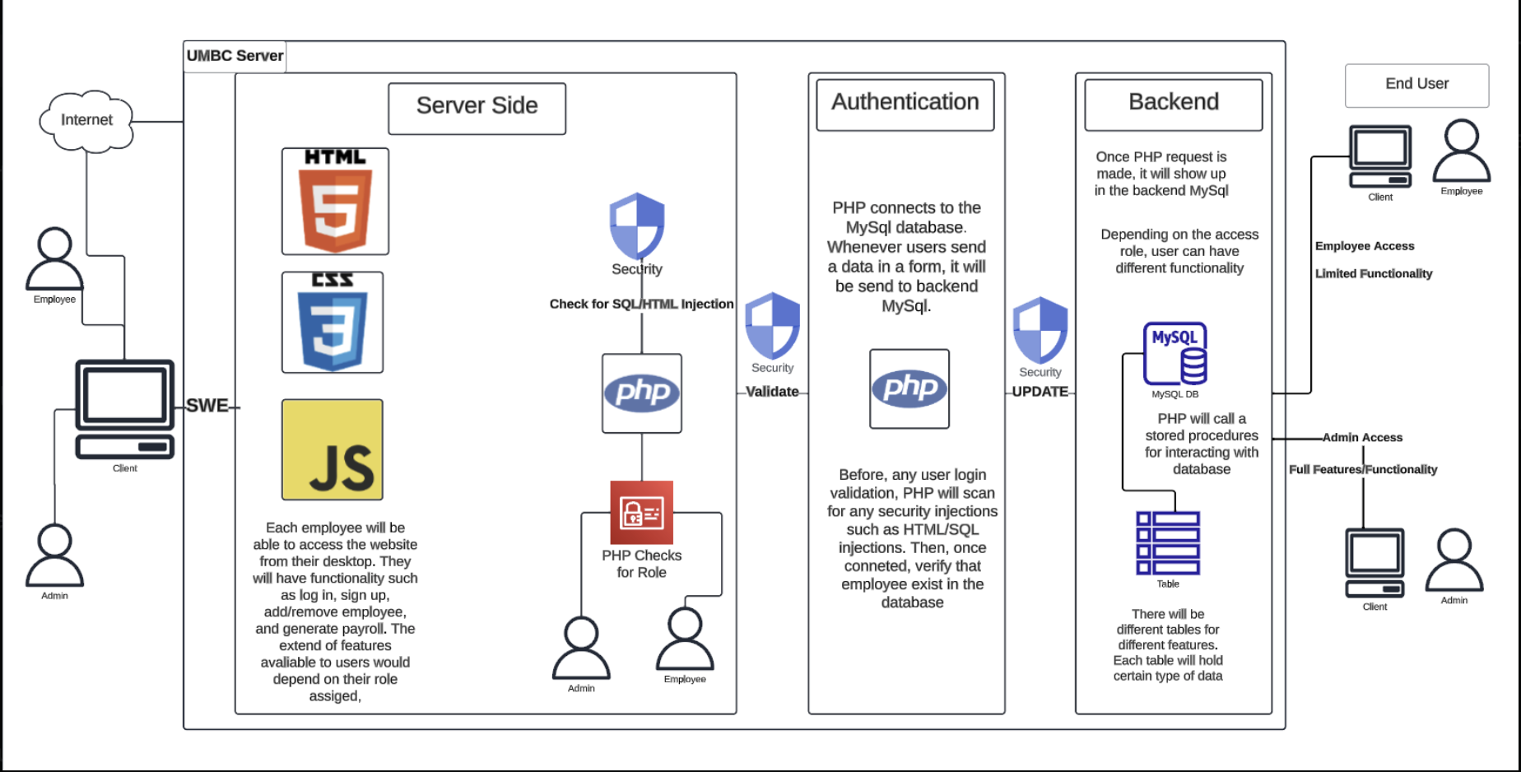
System Architecture
The UMBC server is where the system architecture diagram is designed. The design of this system guarantees security, effective data processing, and a smooth user experience for administrators and staff alike.

Slide 27
User Interface Layer
Employee/Admin Access: A web-based desktop interface is used by users to interact with the system. Because HTML, CSS, and JavaScript were used in its construction, the interface is dynamic and responsive.
Client Side: A variety of web pages and forms allow users to communicate with the database and server-side components. For instance, there is a form to create a payroll report, remove an employee, or add a new employee.

Slide 28
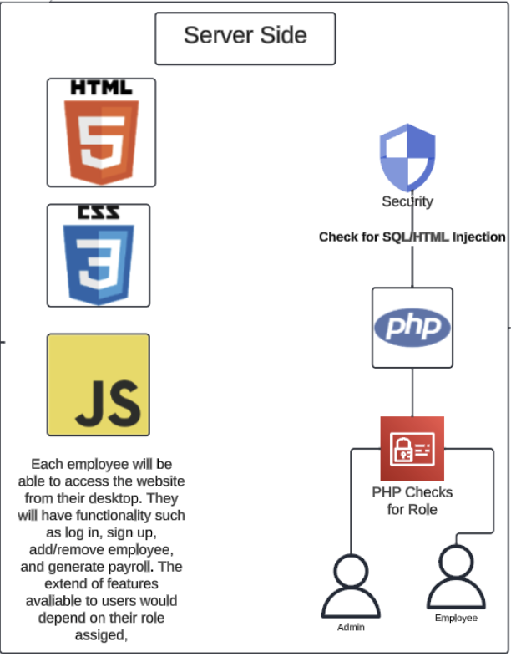
Server-Side
Security measures: UMBC server security features, which include checks against SQL/HTML injection to prevent common web vulnerabilities, safeguard all communications between the client and server. We're going to put some code in place to stop any injection-style attacks.
PHP Processing: For server-side data handling and database connections, PHP will be used. It interacts with the database, handles client requests, and performs logic.
Access Management: To determine what kind of access you have, we will use access management, which is integrated into the PHP file. You can access as a regular employee or as an administrator. The features and functionality will vary based on the type of access you have. PHP will send a query to the database to verify the type of access granted when an employee logs in.

Slide 29
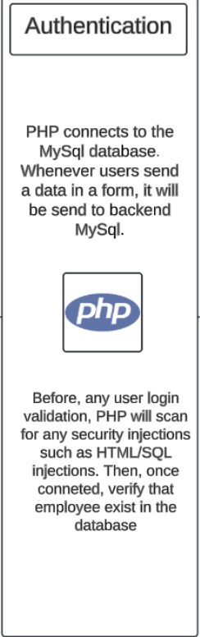
Authentication
User Validation: PHP scripts take care of authentication, making sure that before allowing access, user credentials are checked against the MySQL database. To safeguard confidential information, it will look for security injections.

Slide 30
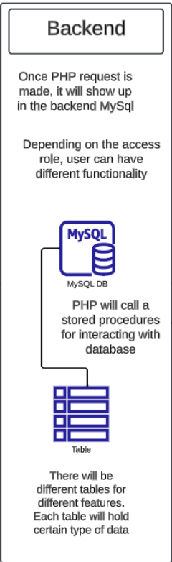
Backend
MySQL Database: All payroll-related data is managed and stored by the system via UMBC server RDS for MySQL. PHP manipulates data by interacting with MySQL via stored procedures and secure queries.
Role-Based Functionality: Users can view their payrolls, clock in and out, and, if they have admin access, carry out administrative functions like adding and removing employees and creating payroll reports, depending on their level of access.

Slide 31
End-User Differentiation of Website
Employee Access: Only personal payroll data and time-tracking features are available to regular employees.
Admin Access: Admin users have access to all features and functionalities, including the ability to manage users and generate reports.

Slide 32
Data Flow and Processing
Client data is sent to the server, where PHP scripts are used to process the input. After that, it is delivered to the database for archiving or retrieval. The server receives the processed data back, and the client receives it for display.

Slide 33
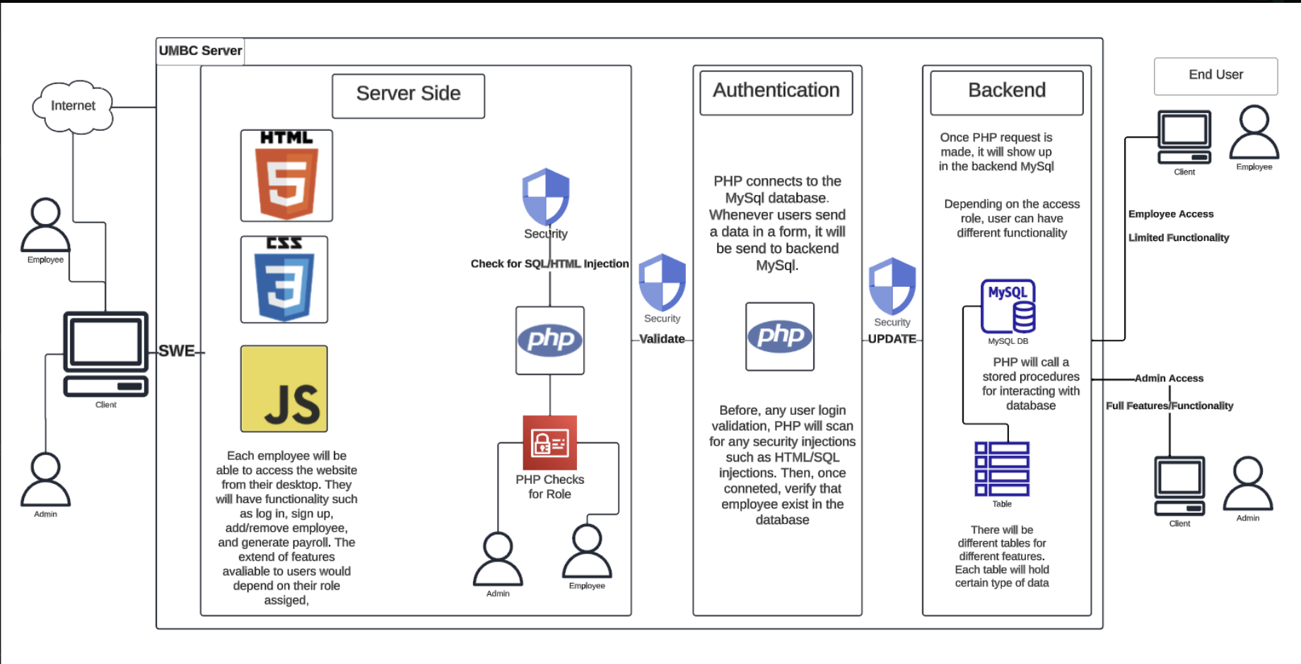
Security and Data Management
To protect data, there are multiple security layers. This covers role-based access control, secure data transmission, server-side injection checks, and front-end validation.

Slide 34
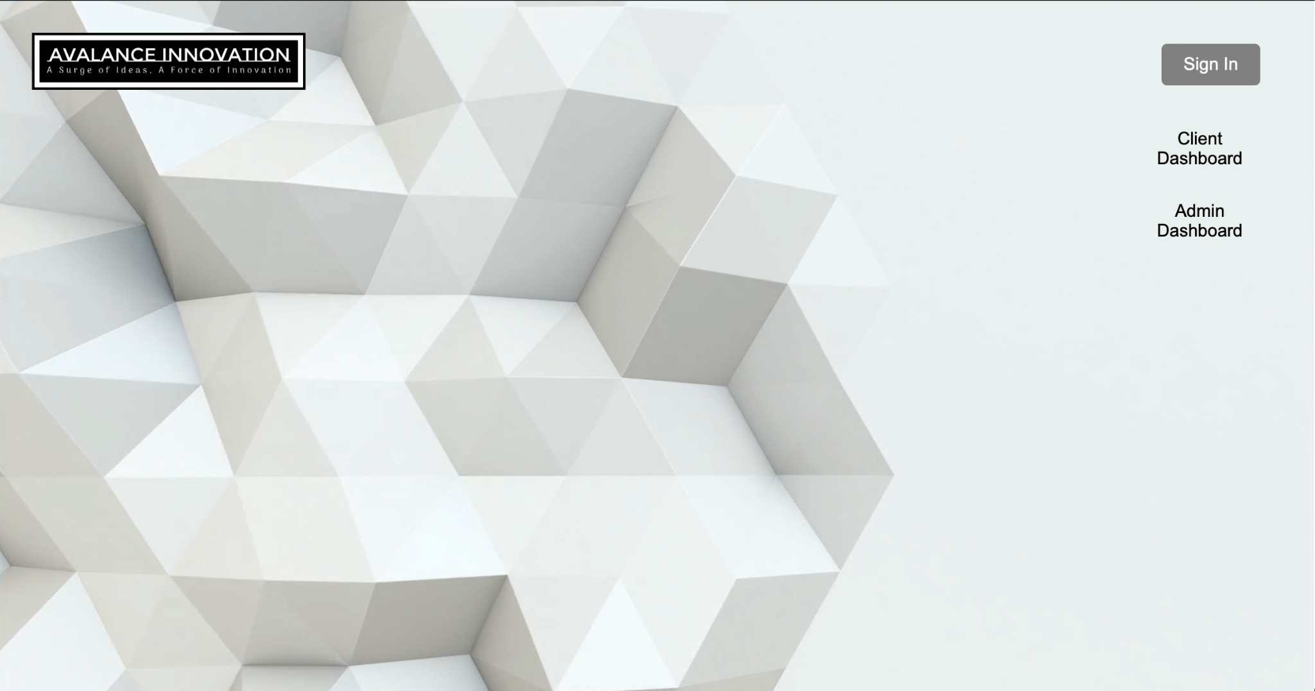
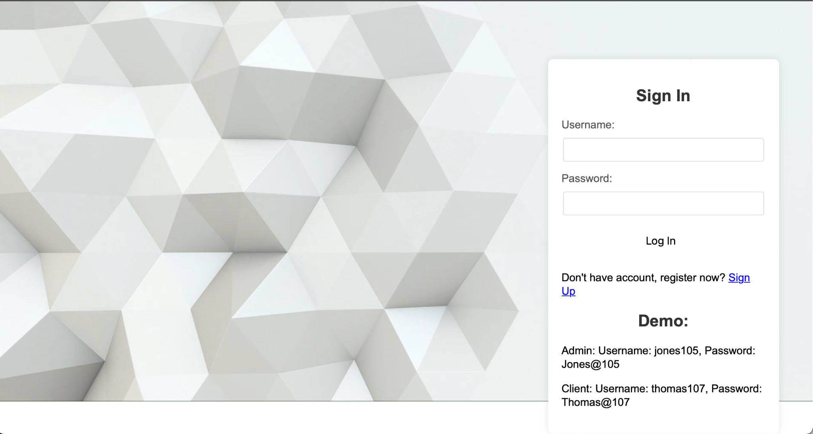
User Interface
Simplicity, consistency, and clarity
Ensuring a positive and intuitive experience
Clear navigation menus enabling users to easily switch between tasks and account settings.

Slide 35
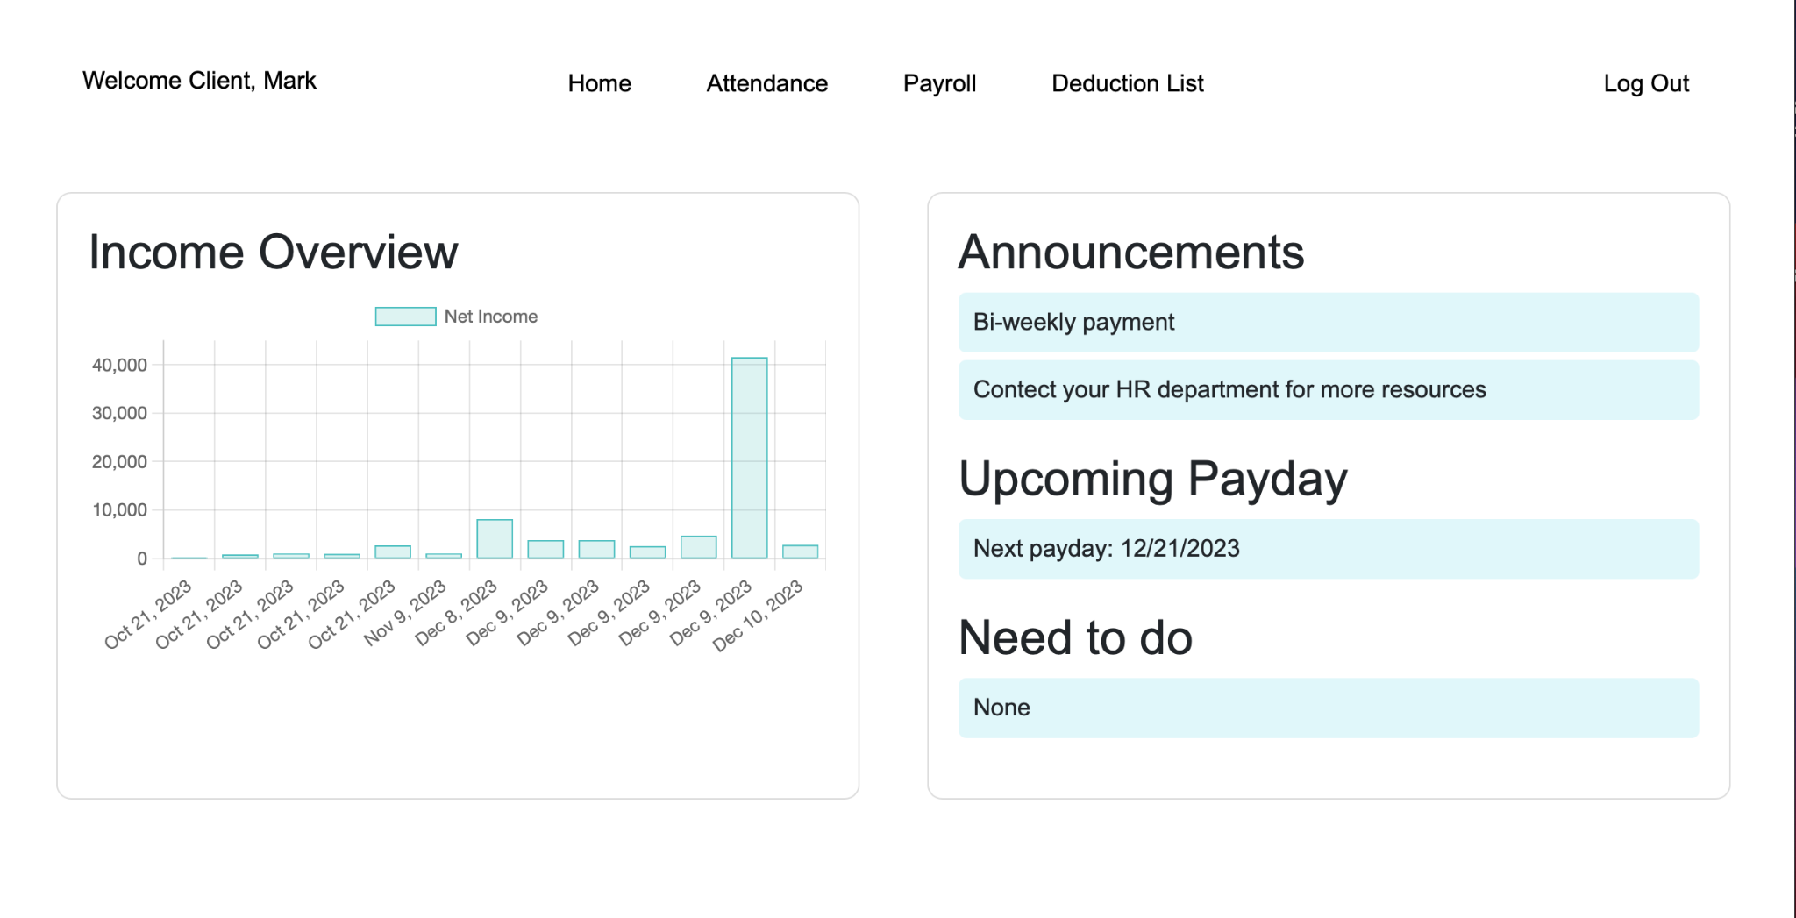
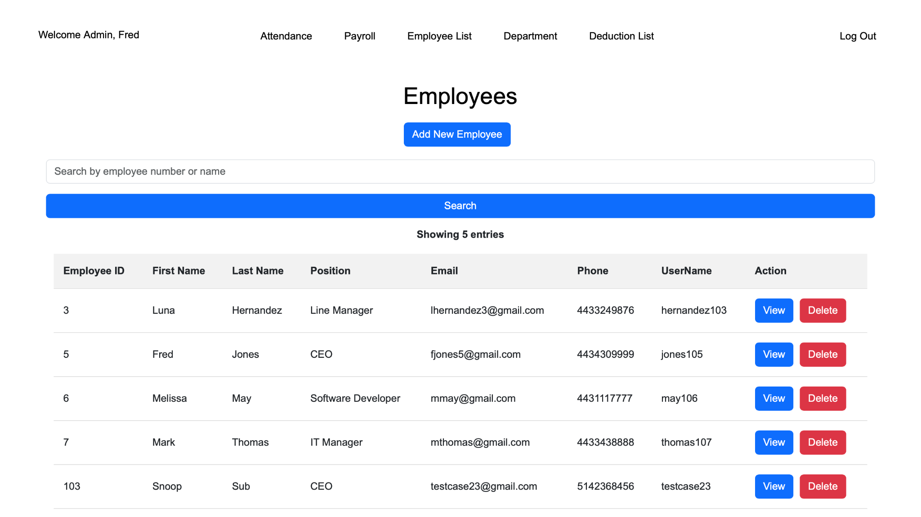
Simplistic look
Easy to navigate
Our logo, color palette, and overall design remain consistent across all pages.
Search bar for easy employee look-up

Slide 36
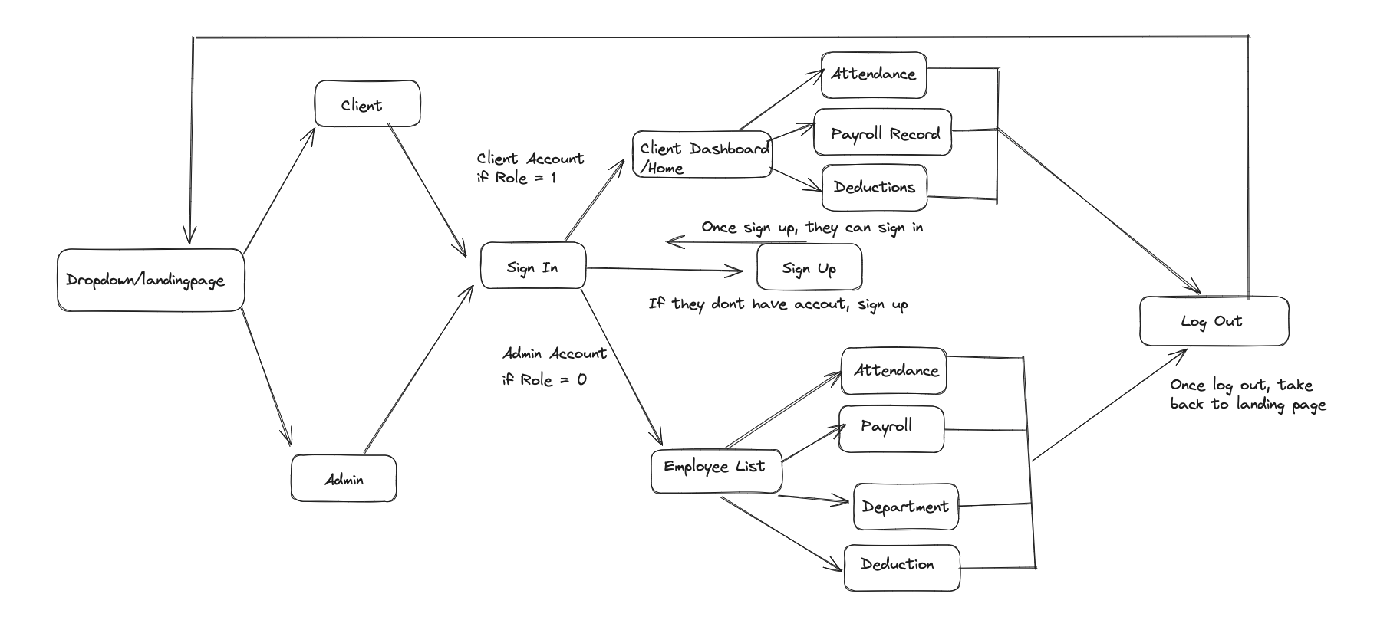
Demo: Site Map

Slide 37
Project Deliverable
GitHub Code Repository:
https://github.com/tnisbett1995/IS-436-Group-7-Project
Live Demo: https://swe.umbc.edu/~nsubba1/prototypev9/PayrollSystem/dropdown.php
GitHub Project: https://github.com/users/tnisbett1995/projects/3/views/12
User Guide Documentation:
https://github.com/tnisbett1995/IS-436-Group-7-Project

